Slide 1
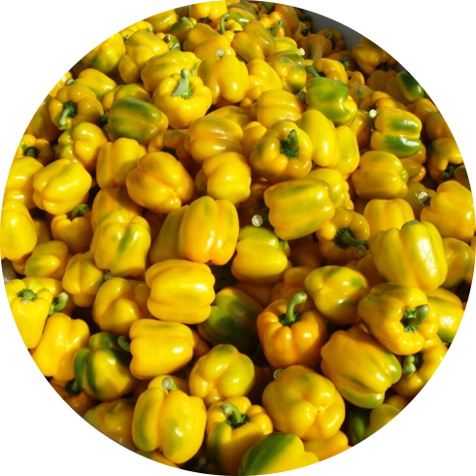
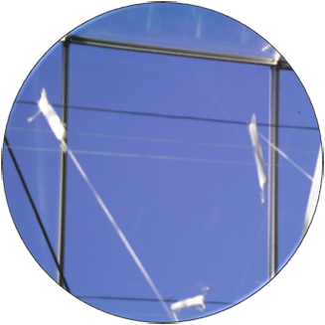
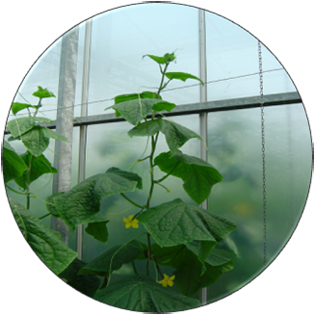
International Workshop on Covering & Screen Materials
25 April 2024
Invitation
Wageningen University & Research Greenhouse Horticulture organises a workshop on Covering & Screen Materials for international participants. Target group are companies (supply industry and growers) active on the field or interested in the topic.
Registration & Costs
For registration go to the FME website: https://fme.powerappsportals.com/event/registration?id=Workshop_on_Covering_Screen_Materials96714405
Wageningen
University & Research
Greenhouse Horticulture Violierenweg 1, 2665 ZG
Bleiswijk, the Neterlands
Programme
9:00 Registration
9:30 Opening & Introduction: Intro: Overview new developments (Silke Hemming)
9:45 Greenhouse systems and crop yield in different climatic region worldwide (Cecilia Stanghellini?)
10:15 Coffee break
10:45 Measurement of most important covering and screen properties (Vida Mohammadkhani)
11:15 Evaluation of material performance – the role of models (Gert-Jan Swinkels)
11:45 Production increase by diffuse light – the importance of Hortiscatter (David Katzin)
12:15 Lunch and Network (poster Smart materials, Energlik, KaEb)
13:15 Visit WUR greenhouse experiments (integral greenhouse concepts: e.g. ETFE greenhouse with strawberries, Winterlight greenhouse with cucumbers, KAS20230 anthurium under low-e
14:15 BEST Kas - results of several years (Monique Bijlaard)
14:45 Energy saving by low-e coatings (Frank Kempkes)
15:15 Coffee break
15:45 UV in the greenhouse – a benefit? (Esther Meinen)
16:10 NIR reflecting materials – the holy grail? (David Katzin)
16:30 Spectrum shifting materials – a future topic? (Silke Hemming)
16:50. Conclusions (Silke Hemming)
17:00 Network drinks
Friday 26 April 2024 10-12: Possibility to visit WUR LightLab, Wageningen

